Slide 1


BCDV 1025
Enterprise Blockchain
2023 February
week 01 - class 01
 | BCDV 1025 Enterprise Blockchain | Pratik Patil

Slide 2
What is Hyperldger Fabric?
 | BCDV 1025 Enterprise Blockchain | Pratik Patil

Slide 3

Hyperledger Fabric is an open-source enterprise-grade permissioned distributed ledger technology (DLT) platform, designed for use in enterprise contexts
 | BCDV 1025 Enterprise Blockchain | Pratik Patil

Slide 4
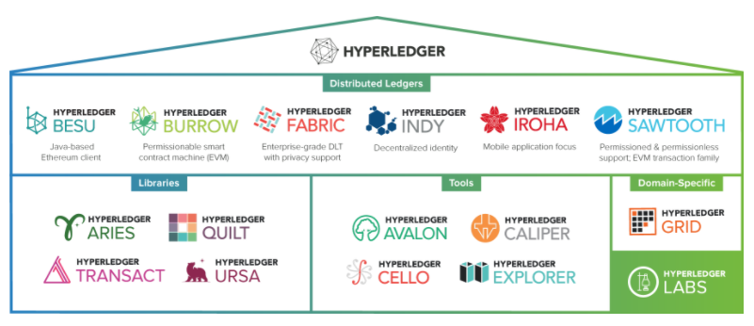
Bit history about the Project.
Hyperledger was established under the Linux Foundation. It is governed by a diverse technical steering committee, and the Hyperledger Fabric project by a diverse set of maintainers from multiple organizations. It has a development community that has grown to over 35 organizations and nearly 200 developers since its earliest commits.
 | BCDV 1025 Enterprise Blockchain | Pratik Patil

Slide 5
Where is it used?
The fabric has a broad range of industry use cases including banking, finance, insurance, healthcare, human resources, supply chain and even digital music delivery.
 | BCDV 1025 Enterprise Blockchain | Pratik Patil

Slide 6
What makes it attractive?
The fabric has a highly modular and configurable architecture, enabling innovation, versatility and optimization.
Its support for pluggable consensus protocols enables the platform to be more effectively customized to fit particular use cases and trust models. For instance, when deployed within a single enterprise, or operated by a trusted authority, fully byzantine fault-tolerant consensus might be considered unnecessary and an excessive drag on performance and throughput.
Fabric can leverage consensus protocols that do not require a native cryptocurrency to incent costly mining or to fuel smart contract execution. Avoidance of a cryptocurrency reduces some significant risk/attack vectors, and the absence of cryptographic mining operations means that the platform can be deployed with roughly the same operational cost as any other distributed system.
 | BCDV 1025 Enterprise Blockchain | Pratik Patil

Slide 7
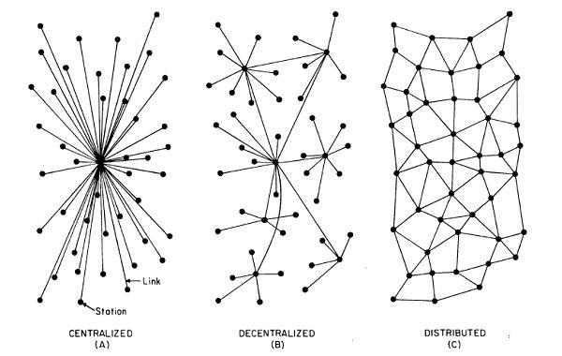
Decentralized Ledger – Only Authorized peers have the copy of ledger.
Distributed Ledger – Each peer have the copy of ledger.
 | BCDV 1025 Enterprise Blockchain | Pratik Patil

Slide 8
Permissioned Vs Permissionless Blockchain
Requires permissions to join and interact with the network | Anyone can join the network
Ledger transparency is limited to the participants | Ledger is transparent globally
Ledger is distributed | Ledger is Decentralized
Data is partially immutable | Data is truly immutable
Custom governance and access policies are implemented | Offers open governance and anonymity
Mining is not necessary | Mining is involved
 | BCDV 1025 Enterprise Blockchain | Pratik Patil

Slide 9
Use Case:
 | BCDV 1025 Enterprise Blockchain | Pratik Patil

Slide 10
Supply chain Industry:
Lets take an example of a truck carrying an Ice-cream. Now as we know Ice-cream is a very temperature sensitive thing to transport. Even a slightest temperature difference can ruin the entire inventory.
Now lets assume we have Company A (Manufacturer), Company B (Transporter) and Company C (Retailer).
Now, Company B was transporting it by truck and due some issues in between their cooling system failed. Now, when the Company C when they received this inventory it was in the damaged condition.
Now when the retailer complained the Company B refused to take the liability just as Company A.
Now, this problem can be solved using blockchain.
How, Each company can maintain a same a ledger where a real time data from the temperature sensors can be imputed from the time of manufacturing to the retailer receiving the delivery. This will bring the transparency in the whole supply chain of the product and liabilities.
 | BCDV 1025 Enterprise Blockchain | Pratik Patil

Slide 11
Main Components of the Network:
 | BCDV 1025 Enterprise Blockchain | Pratik Patil

Slide 12
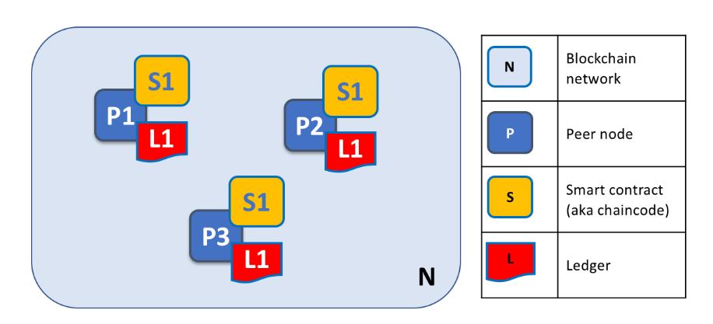
Peers
Fundamental element of a Hyperledger Fabric blockchain network is the set of peer nodes (or, simply, peers). Peers are fundamental because they manage ledgers and smart contracts.
 | BCDV 1025 Enterprise Blockchain | Pratik Patil

Slide 13
Orderers
The mechanism by which applications and peers interact with each other to keep the ledger current and consistent across a channel is mediated by special nodes called orderers. It’s to these orderer nodes that we now turn our attention.
 | BCDV 1025 Enterprise Blockchain | Pratik Patil

Slide 14
Certificate Authority
Hyperledger Fabric CA is the default Certificate Authority component, which issues PKI-based certificates to network member organizations and their users. The CA issues one root certificate (rootCert) to each member and one enrollment certificate (ECert) to each authorized user.
 | BCDV 1025 Enterprise Blockchain | Pratik Patil

